Slide 1
Working Title
By Louis Kift

Slide 2
Basic Overview
You can choose between being a piece of Bacon and a Barbie like doll, causing chaos in restaurants and cafes.
Your objectives are to mess up the customers orders and to save the other ingredients from being eaten.
You will spawn on the floor and have to work your way up using some objects (parkour).
In this game you will need to cause mischief by saving other items of food from the people eating and cooking the food.

Slide 3
Why Bacon
I think that if the main character was a piece of bacon that the community would react positively towards the game.
I don’t want to have it as an small animal that would fit in the small spaces as a mouse or rat, as it has done multiple times before e.g. Rattatouie.
Everyone loves bacon!
I am also hoping to add a second character, which is a doll, similar to a Barbie.

Slide 4
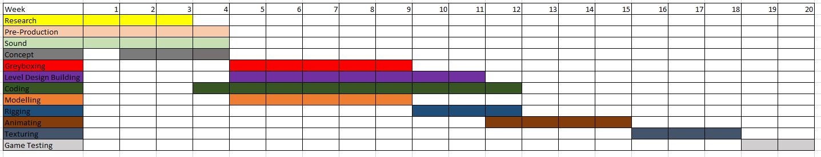
Gant chart

Slide 5
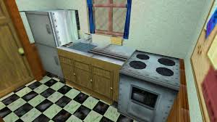
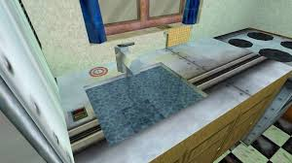
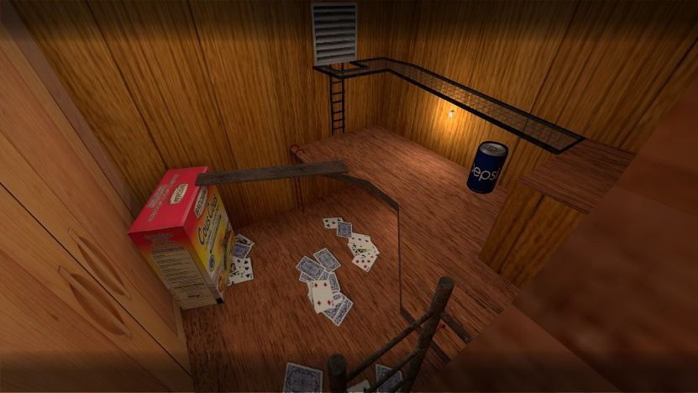
Map Design Inspiration
A map that sort of inspired me was de_rats from counter strike.
This map is a good example of how I would like the map to play out with the player being a small character in a big area.
But unlike de_rats I would use focus slightly more on parkour aspect so it would make the game a bit more challenging for the players.

Slide 6
Sounds.
In the game you are based inside a restaurant or café, for this reason, we will gather some noises and ambience for a café or restaurant.
As well as this when the character jumps or runs into a wall it will produce a sound effect.

Slide 7
Parkour Animations.
A piece of bacon is not known to jump or carry things yet this piece can do just that.
The parkour animations are going to consist mainly of swash and stretch similar to Disney cartoons in there extremity’s.
As for the bi-pedal character it would be quite similar to the premade Unreal Engine characters animations.

Slide 8
This is achievable.

Slide 9
Prototype.

